Slide 1



EU Regulation 608/2013
This project is funded by
the European Union
Kenny Wright.
Support to Enforcement of IPR.
Chisinau, February 2018.

Slide 2
Objective
To review EU Regulation No.608/2013
concerning Customs enforcement of IPR.
Notes:
Background (10 years have past...)
Problems and needs (new challenges…)
General Concept (modernization)
Draft ideas (fit for all)
Further steps (new Action Plan and New Regulation)

Slide 3
Agenda
Small Consignments.
Conclusion.
Highlights.
Exchange of Information.
Notes:
AFA remains basis.
In line with TRIPs / enforcement directive.
Simplification and modernisation to reduce costs.
Maximize harmonisation of procedures of customs administrations *customs clearance…)
Strengthening of enforcement of IPR by Customs.

Slide 4
Highlights
Trade Names.
Topographies of semiconductor products.
Utility models.
Circumvention Devices.
Notes:
Definition of counterfeit goods.

Slide 5



Highlights
Trade Names.

Slide 6
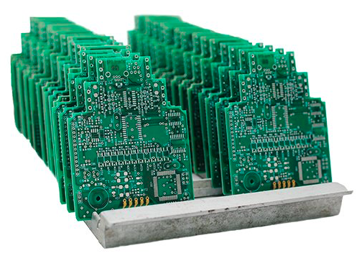
Highlights
Topographies of semiconductor products.

Slide 7
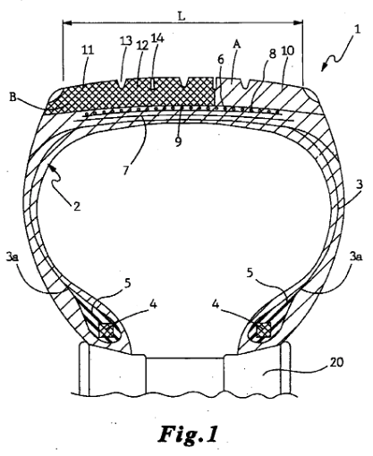
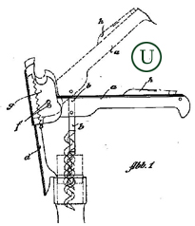
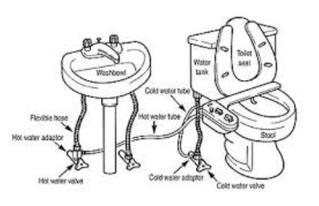
Highlights
Utility models.

Slide 8

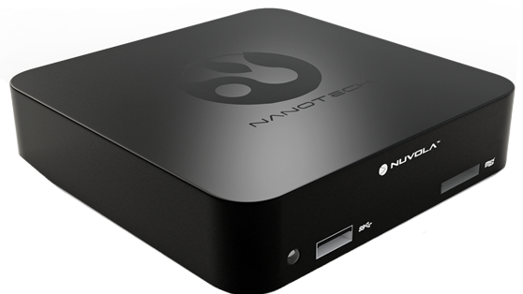
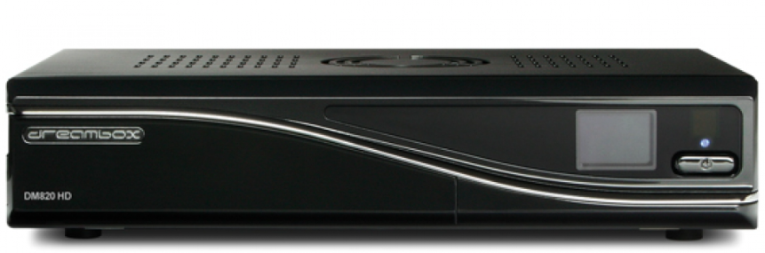
Highlights
Circumvention Devices.

Slide 9
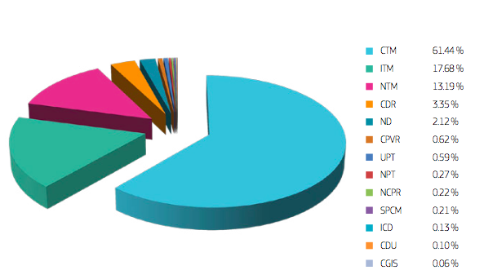
Highlights

Slide 10
Highlights
Non-Commercial Nature.
Parallel Trade.
Over runs.
Transit.

Slide 11
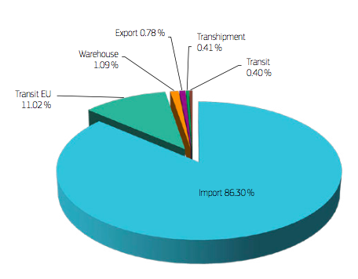
Highlights

Slide 12
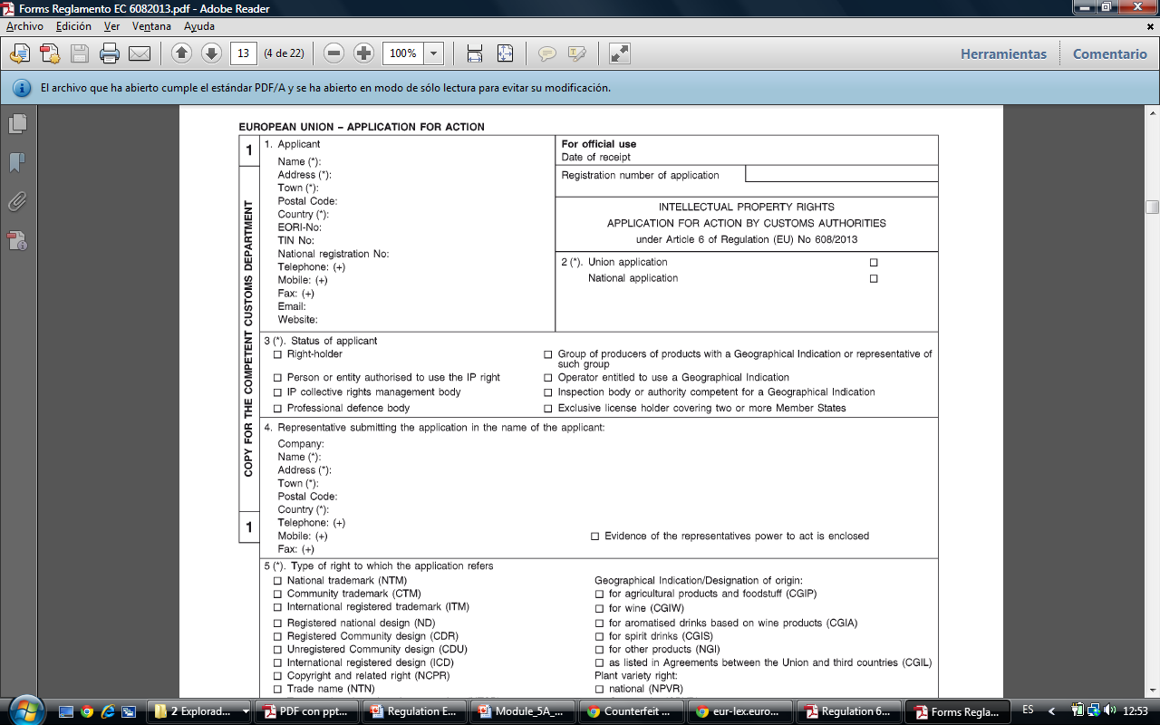
Highlights
National Application.
Union Application.
Online Option.

Slide 13
Highlights
Perishable Goods Definition - 20 days.
Simplified procedure mandatory.
Ex-officio - 4 days.

Slide 14
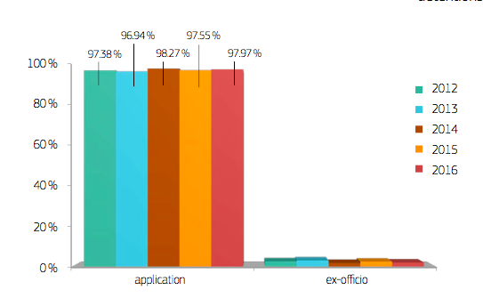
Highlights

Slide 15
Highlights
Obtain photographs.
Inspect goods.
Obtain samples.

Slide 16
Agenda
Small Consignments.
Conclusion.
Highlights.
Exchange of Information.
Notes:
AFA remains basis.
In line with TRIPs / enforcement directive.
Simplification and modernisation to reduce costs.
Maximize harmonisation of procedures of customs administrations *customs clearance…)
Strengthening of enforcement of IPR by Customs.

Slide 17
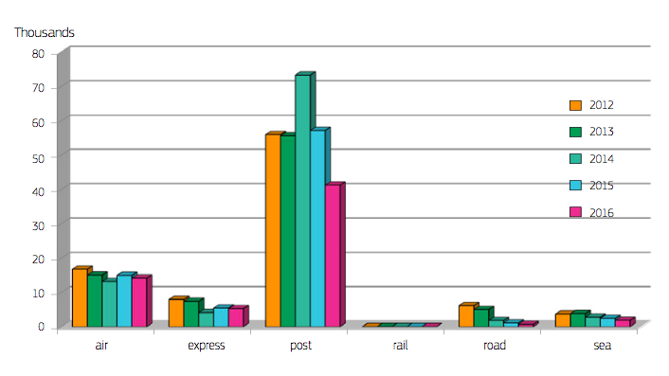
Small Consignment Procedure

Slide 18
Small Consignment Procedure
Ex-Officio Procedure.
Standard Procedure.
Small Consignment Procedure.

Slide 19
Small Consignment Procedure
Procedure requested by applicant.
Application approved.
Only suspected counterfeit or pirate goods.
Not perishable.

Slide 20
Small Consignment Procedure
Transported by post or fast courier.
Not more than three articles.
Not more than two kilograms.

Slide 21
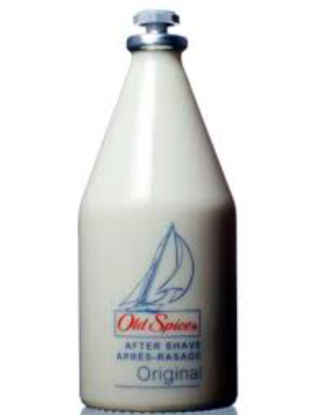
Small Consignment Procedure

Slide 22



Small Consignment Procedure

Slide 23
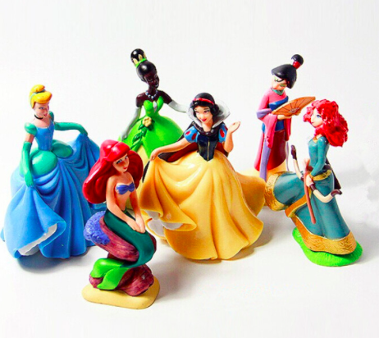
Small Consignment Procedure

Slide 24


Small Consignment Procedure

Slide 25

Small Consignment Procedure

Slide 26
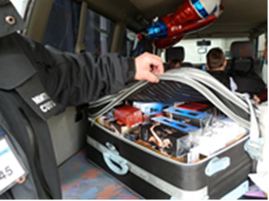

Slide 27
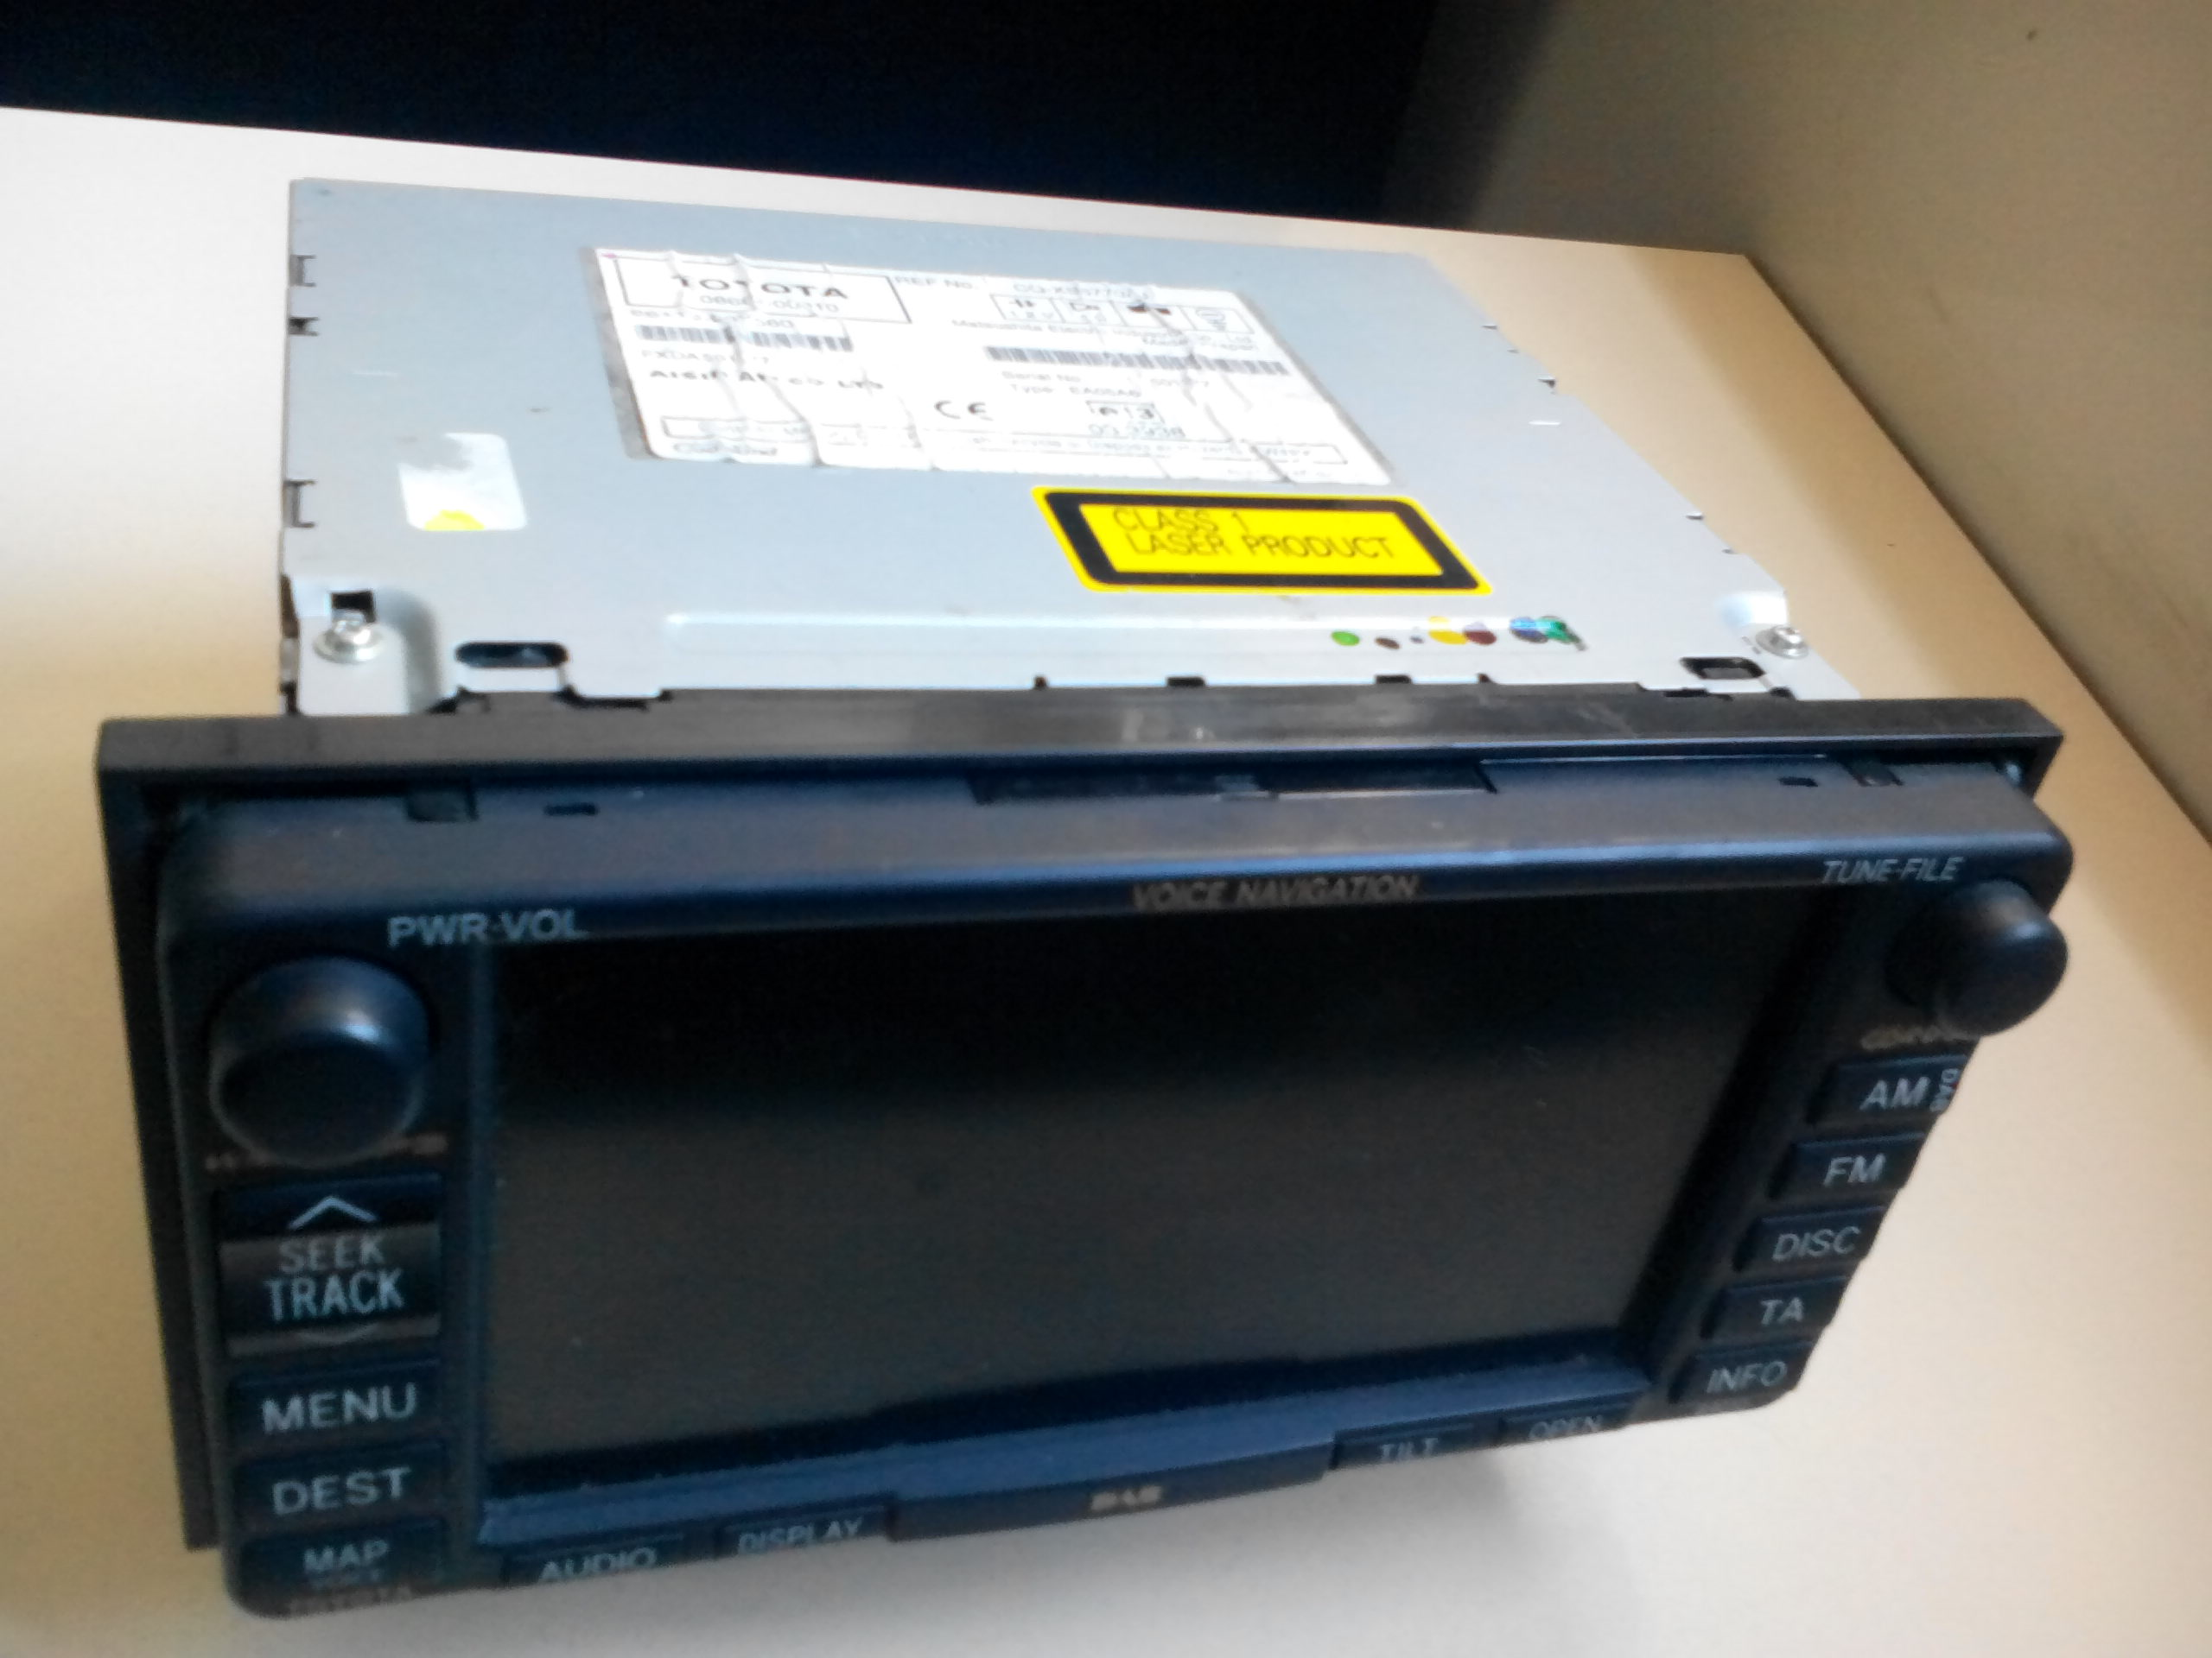

Slide 28
Small Consignment Procedure
Customs Control
Release
Suspend Release
Notify Right Holder
Court
Notify Holder of Goods
Objection
Destroy
Goods
Destruction

Slide 29
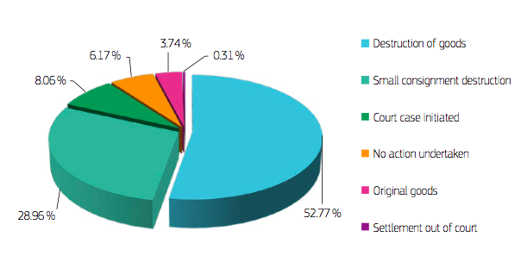
Small Consignment Procedure

Slide 30
Agenda
Small Consignments.
Conclusion.
Highlights.
Exchange of Information.
Notes:
AFA remains basis.
In line with TRIPs / enforcement directive.
Simplification and modernisation to reduce costs.
Maximize harmonisation of procedures of customs administrations *customs clearance…)
Strengthening of enforcement of IPR by Customs.

Slide 31
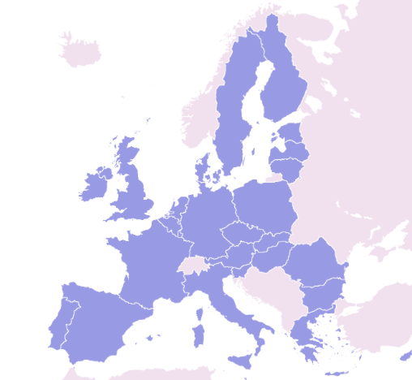
Exchange of Information

Slide 32
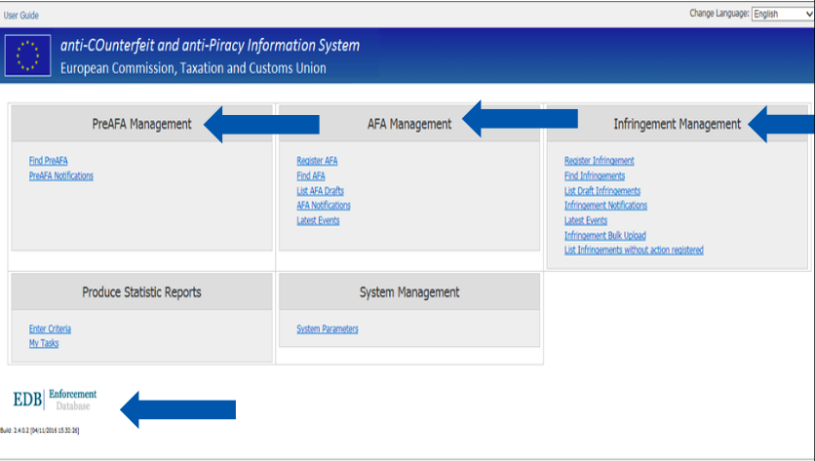
Exchange of Information
EU Map
Notes:
Read Objective of Presentation.

Slide 33
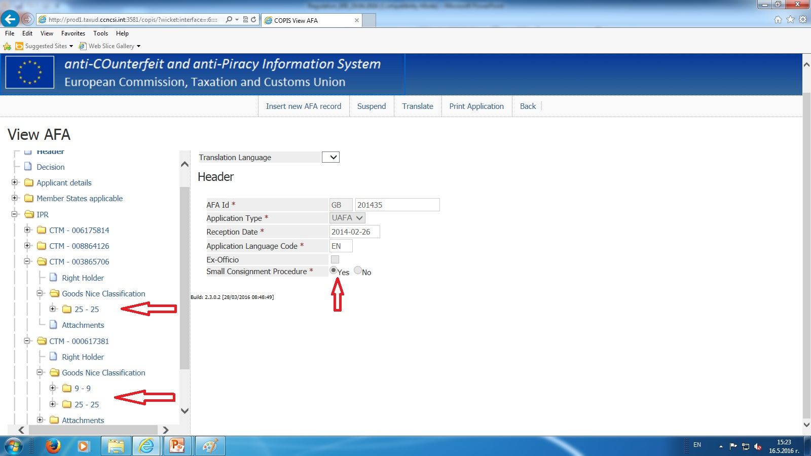

Slide 34
Agenda
Small Consignments.
Conclusion.
Highlights.
Exchange of Information.
Notes:
AFA remains basis.
In line with TRIPs / enforcement directive.
Simplification and modernisation to reduce costs.
Maximize harmonisation of procedures of customs administrations *customs clearance…)
Strengthening of enforcement of IPR by Customs.

Slide 35
Conclusion
 | 1308/2003 | 608/2013
SCOPE | NAMED. | 1383/2003 PLUS FOUR.
PARALLEL TRADE | NO MENTION. | EXCLUDED FROM REGULATION.
TRANSIT | NO MENTION. | NO MENTION BUT TRADEMARK REGULATION & DIRECTIVE.
EX-OFFICIO | 3 DAYS. | 4 DAYS.
APPLICATIONS | NATIONAL. | NATIONAL AND UNION.
PERISHABLE GOODS | NO DEFINITION. | GOODS THAT LOSE THEIR EDGE WITHIN 20 DAYS.
SIMPLIFIED PROCEDURE | OPTIONAL. | MANDATORY.
SMALL CONSIGNMENTS | NO PROCEDURE. | PROCEDURE.
INFORMATION | NO REQUIREMENT. | COPIS.

Slide 36
EU Regulation 608/2013
Kenny Wright.
Support to Enforcement of IPR.
Chisinau, February 2018.

