Slide 1
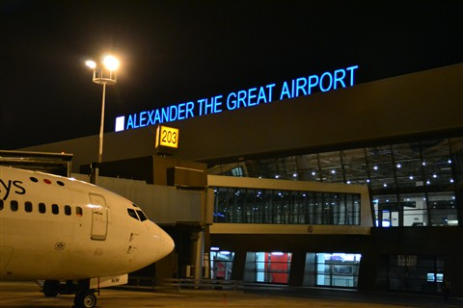
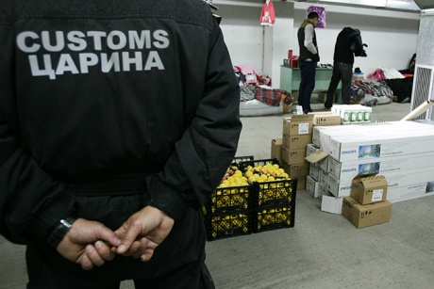

SCENARIO 1 A

Slide 2
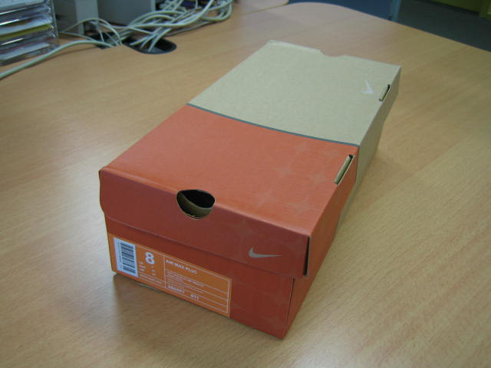
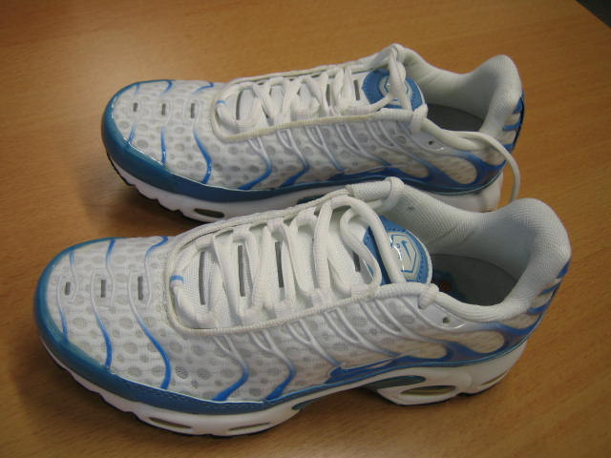

Slide 3
Questions
What is the procedure for IPR related to these goods?
Who needs to be informed within Customs?
Which rights are infringed in this shipments?

Slide 4
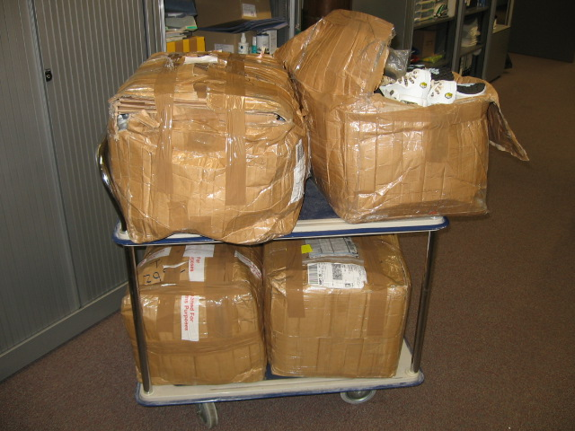
SCENARIO 1 B

Slide 5
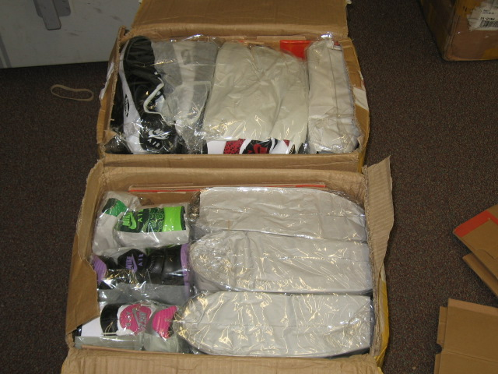

Slide 6
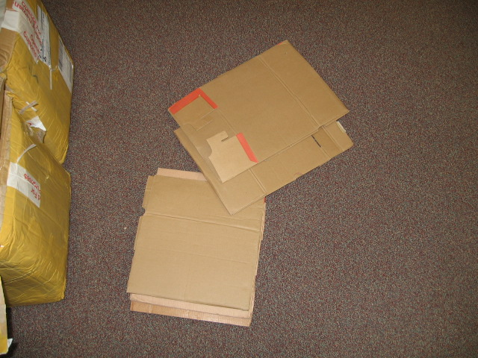
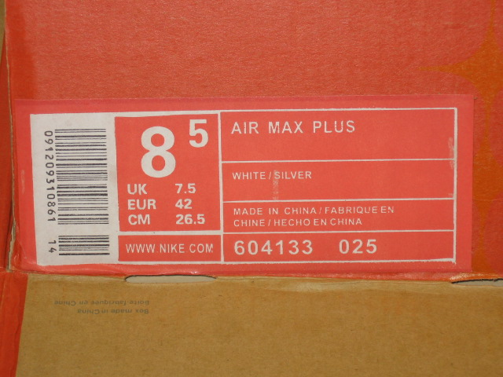

Slide 7
Questions
What is the procedure for IPR related to these goods?
Who needs to be informed within Customs?
Which rights are infringed in this shipments?
What does it mean if you see these goods together?

Slide 8

3 Case study Air Cargo/Couriers
At Skopje Airport you inspect a DHL shipment

Slide 9
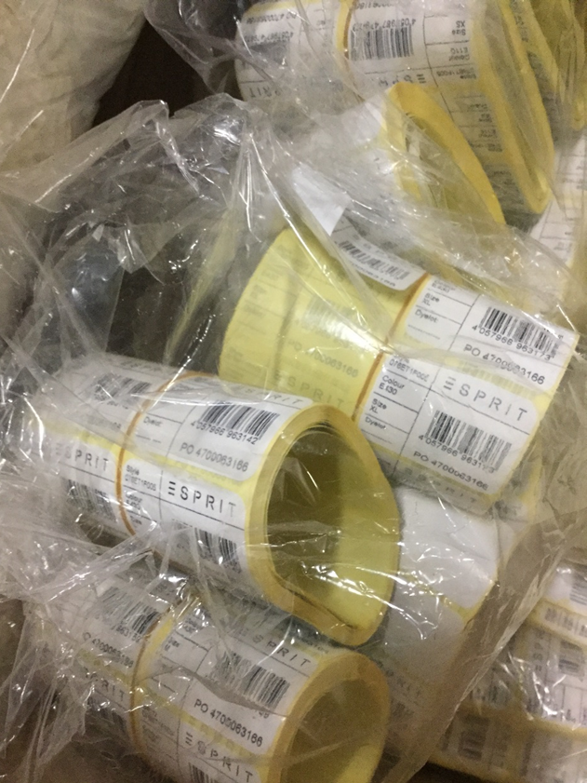
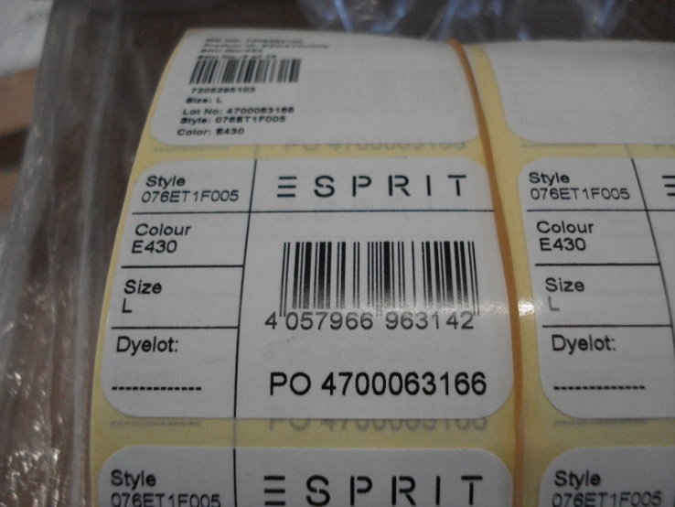
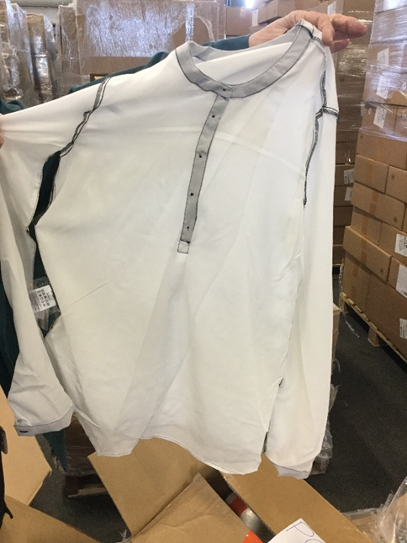
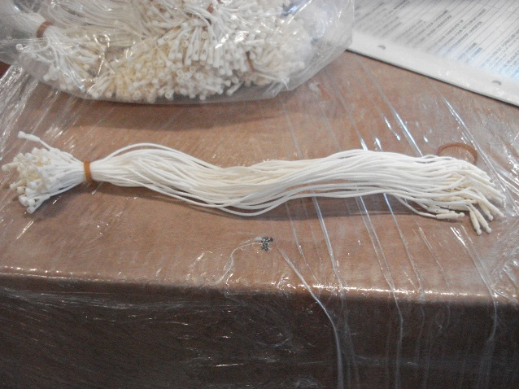
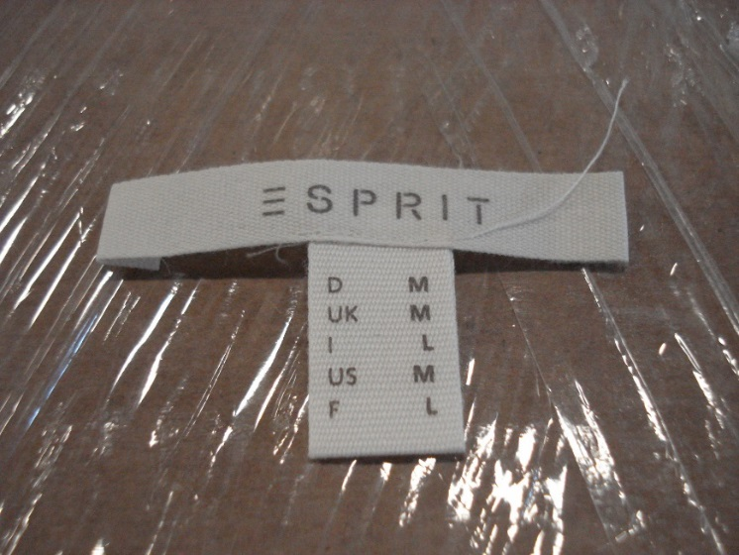
After opening the package you find the goods below

Slide 10
Questions
What is the procedure for IPR related to these goods?
Who needs to be informed within Customs?
Which rights are infringed in this shipments?
What does it mean if you see these goods together

Slide 11
Questions
What will be the follow up on this shipment regarding to risk analysis or intelligence @Customs?
Is there need to involve other enforcement agencies within MK
Why Yes/No

Slide 13

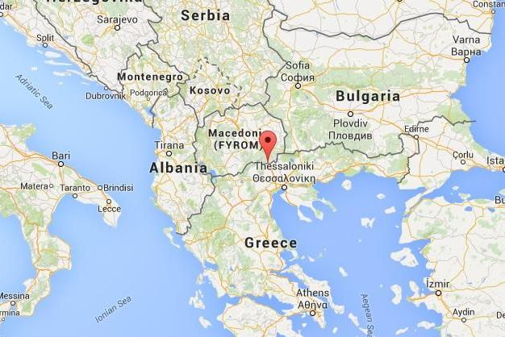
SCENARIO 2

Slide 14

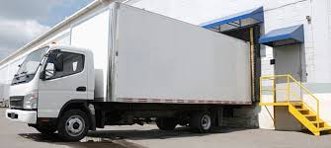

Slide 15
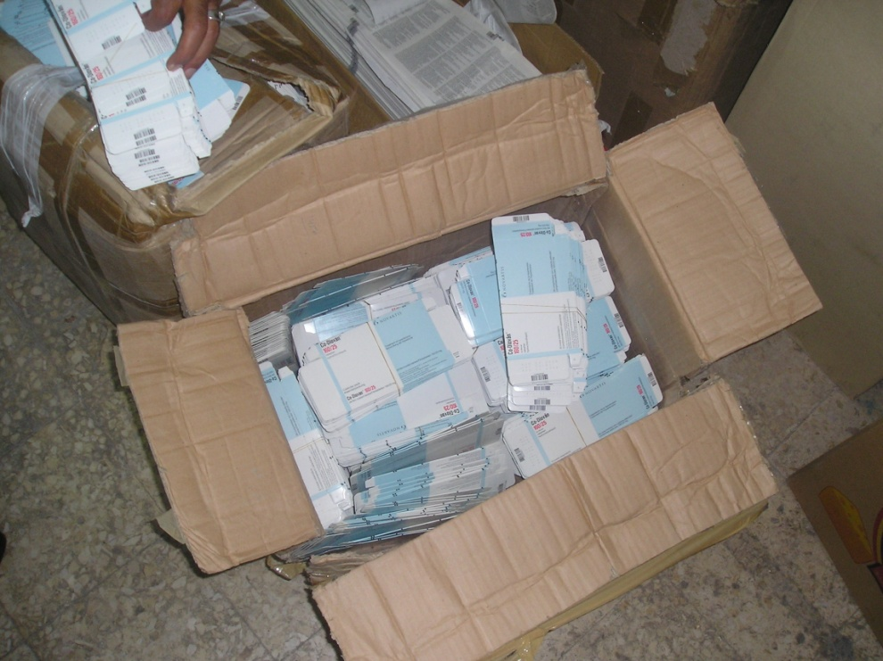
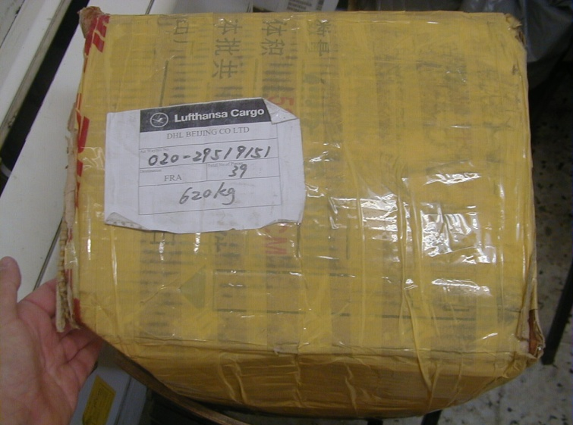
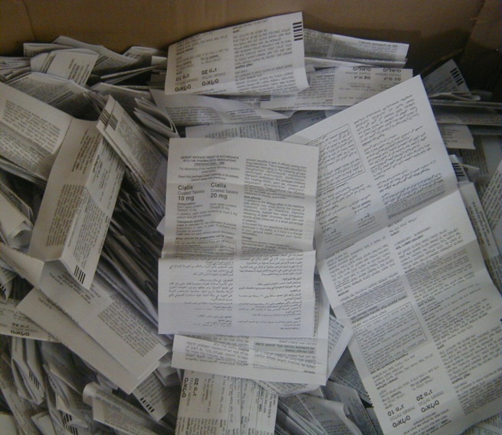
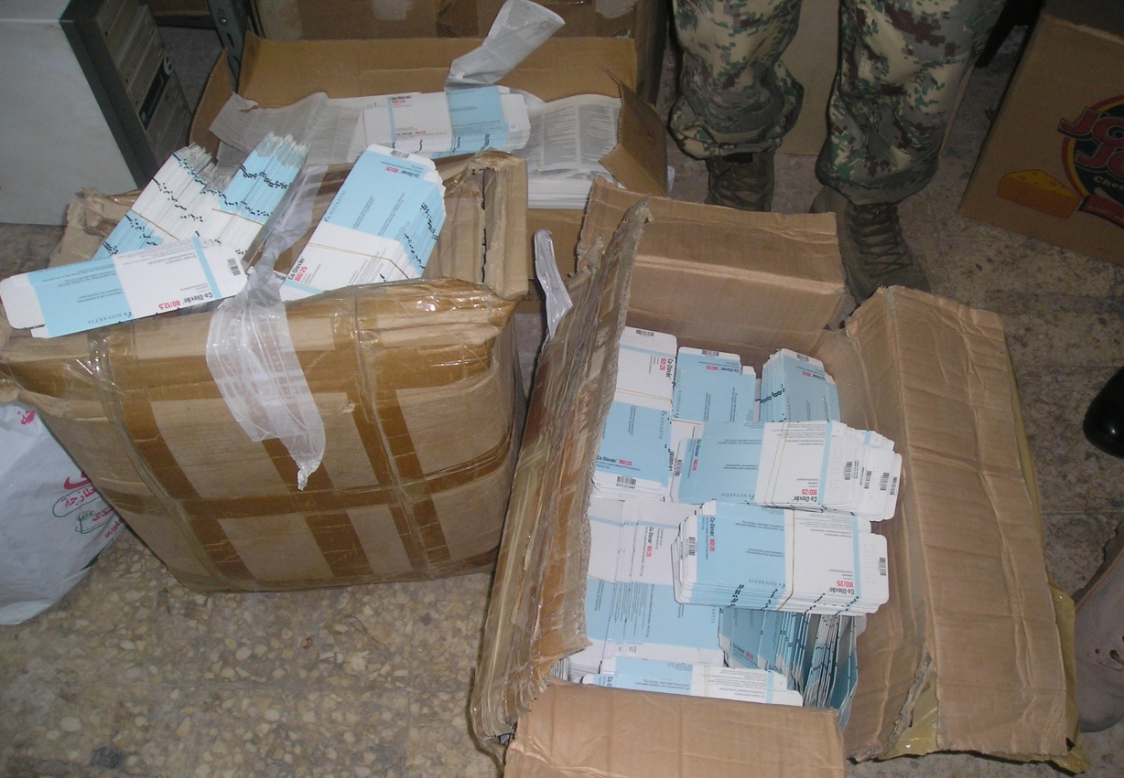
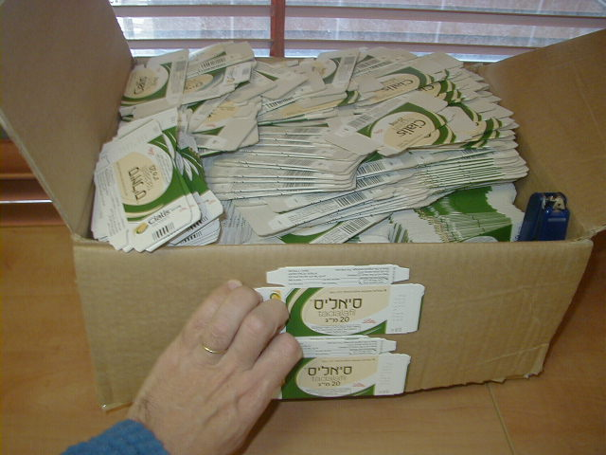
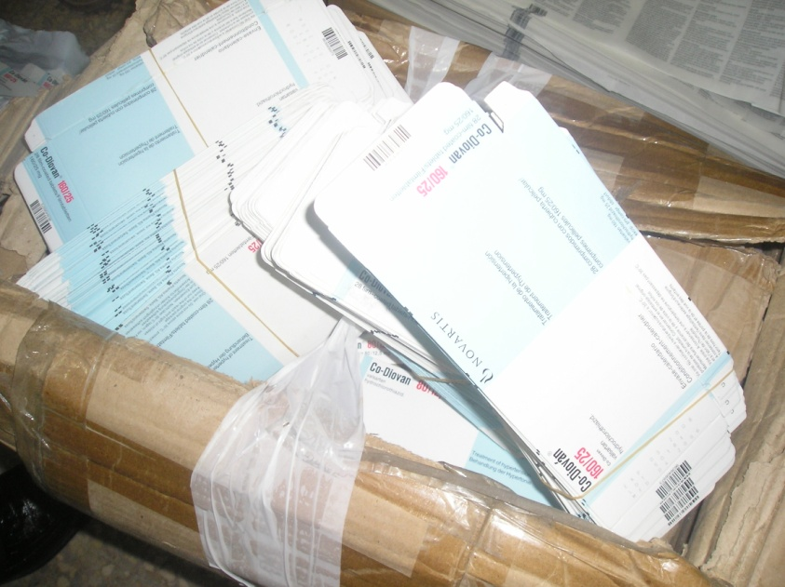
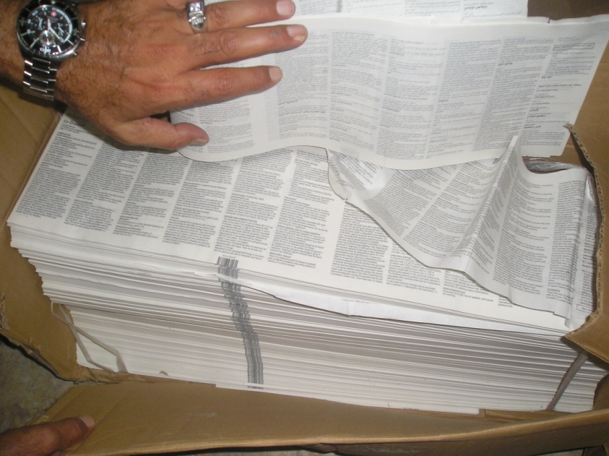
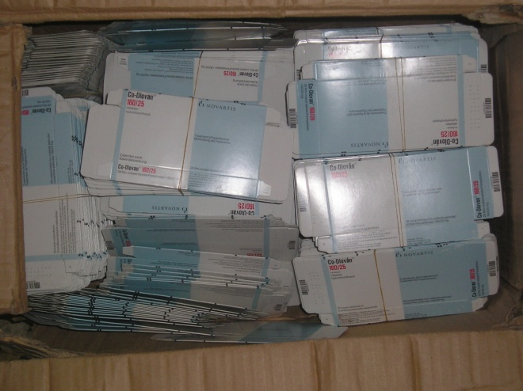
  15
Result of searching
a truck

Slide 16
Questions
Is it an IPR infringment?
When yes, which rights are infringed in this shipments?
What is the procedure for these goods?
Who needs to be informed within Customs?
What does it mean if you see these goods together

Slide 17
Questions
What will be the follow up on this shipment regarding to risk analysis or intelligence @Customs?
Is there need to involve other enforcement agencies within MK
Why Yes/No

