Slide 1



Introduction to
Intellectual Property
This project is funded by
the European Union
Kenny Wright.
Support to Enforcement of IPR.
Chisinau, February 2018.

Slide 2
Intellectual Property
To briefly discuss intellectual property
and how it is protected

Slide 3
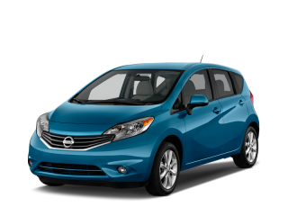
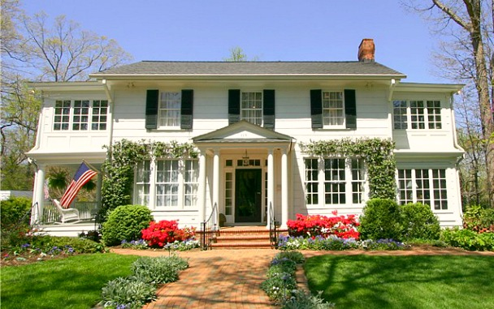
Intellectual Property
Property
Tangible
Tangible
Intellectual

Slide 4
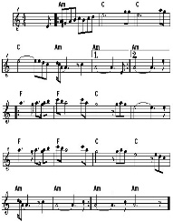

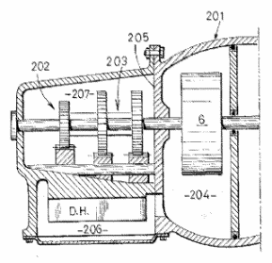
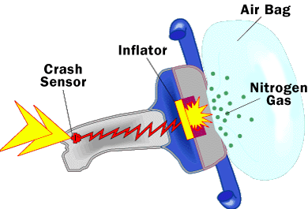
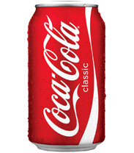

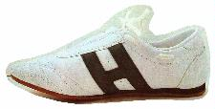
Intellectual Property
Legal right
What for?
How?
Copyright
Original creative or artistic forms
Exists automatically
Patents
New inventions
Application and registration
Trademarks
Distinctive Identification of goods or services
Registration
Industrial designs
External appearance
Registration
Notes:
IP rights can divided in different categories, according to the type of innovation or creation that is the object of protection.
Patents: Only inventions can be patented and they will be disclosed to the public. The patent office will examine the patent application to determine whether the stringent requirements for a patent grant are met.
Copyright: Copyright includes, for example, literature, art, drama, music, photographs, recordings, broadcasts, etc.
Trade marks: Trade marks are distinctive signs or indicators of the source of a product or service, e.g. names, logos, colours applied to the owner's products or services, which distinguish them from products or services provided by competitors.
Registered designs: Registered designs protect the external appearance of a product. They do not give any protection for technical aspects. They include new patterns, ornaments and shapes. To be officially registered, designs need to be original and distinctive. The artistic aspects of a design may also be protected by copyright.
*Unregistered designs also enjoy some protection. An unregistered design is a free, automatic right that you get when you present a design to the public. It gives you the right to stop anyone from copying your design but typically the protection afforded by an unregistered design is of more limited duration than that available for a registered design.
Trade secrets: This is an alternative to patents. Trade secrets cover information not known to the public. If the possessor of such information is careful to keep the information confidential (e.g. by signing non-disclosure agreements with employees/partners) he can sue anyone who steals it. However, trade secrets offer no protection against reverse-engineering or against competitors who independently make the same invention.

Slide 5
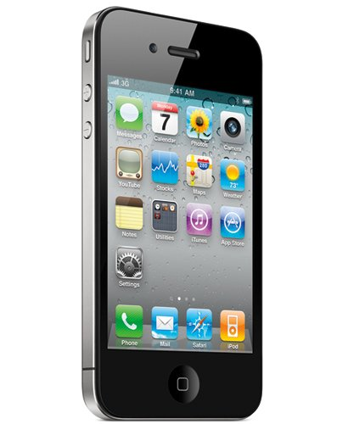

Intellectual Property
Copyright Software.
Patents Touch screen.
Trademark
Trademark Start up tone.
Design Phone shape.

Slide 6

Novelty and Individual Character

Slide 7




Intellectual Property
National Protection -
Regional Protection -
Regional Protection -
Global Protection -

Slide 8
Introduction to
Intellectual Property
Kenny Wright.
Support to Enforcement of IPR.
Chisinau, February 2018.

